Slide 1
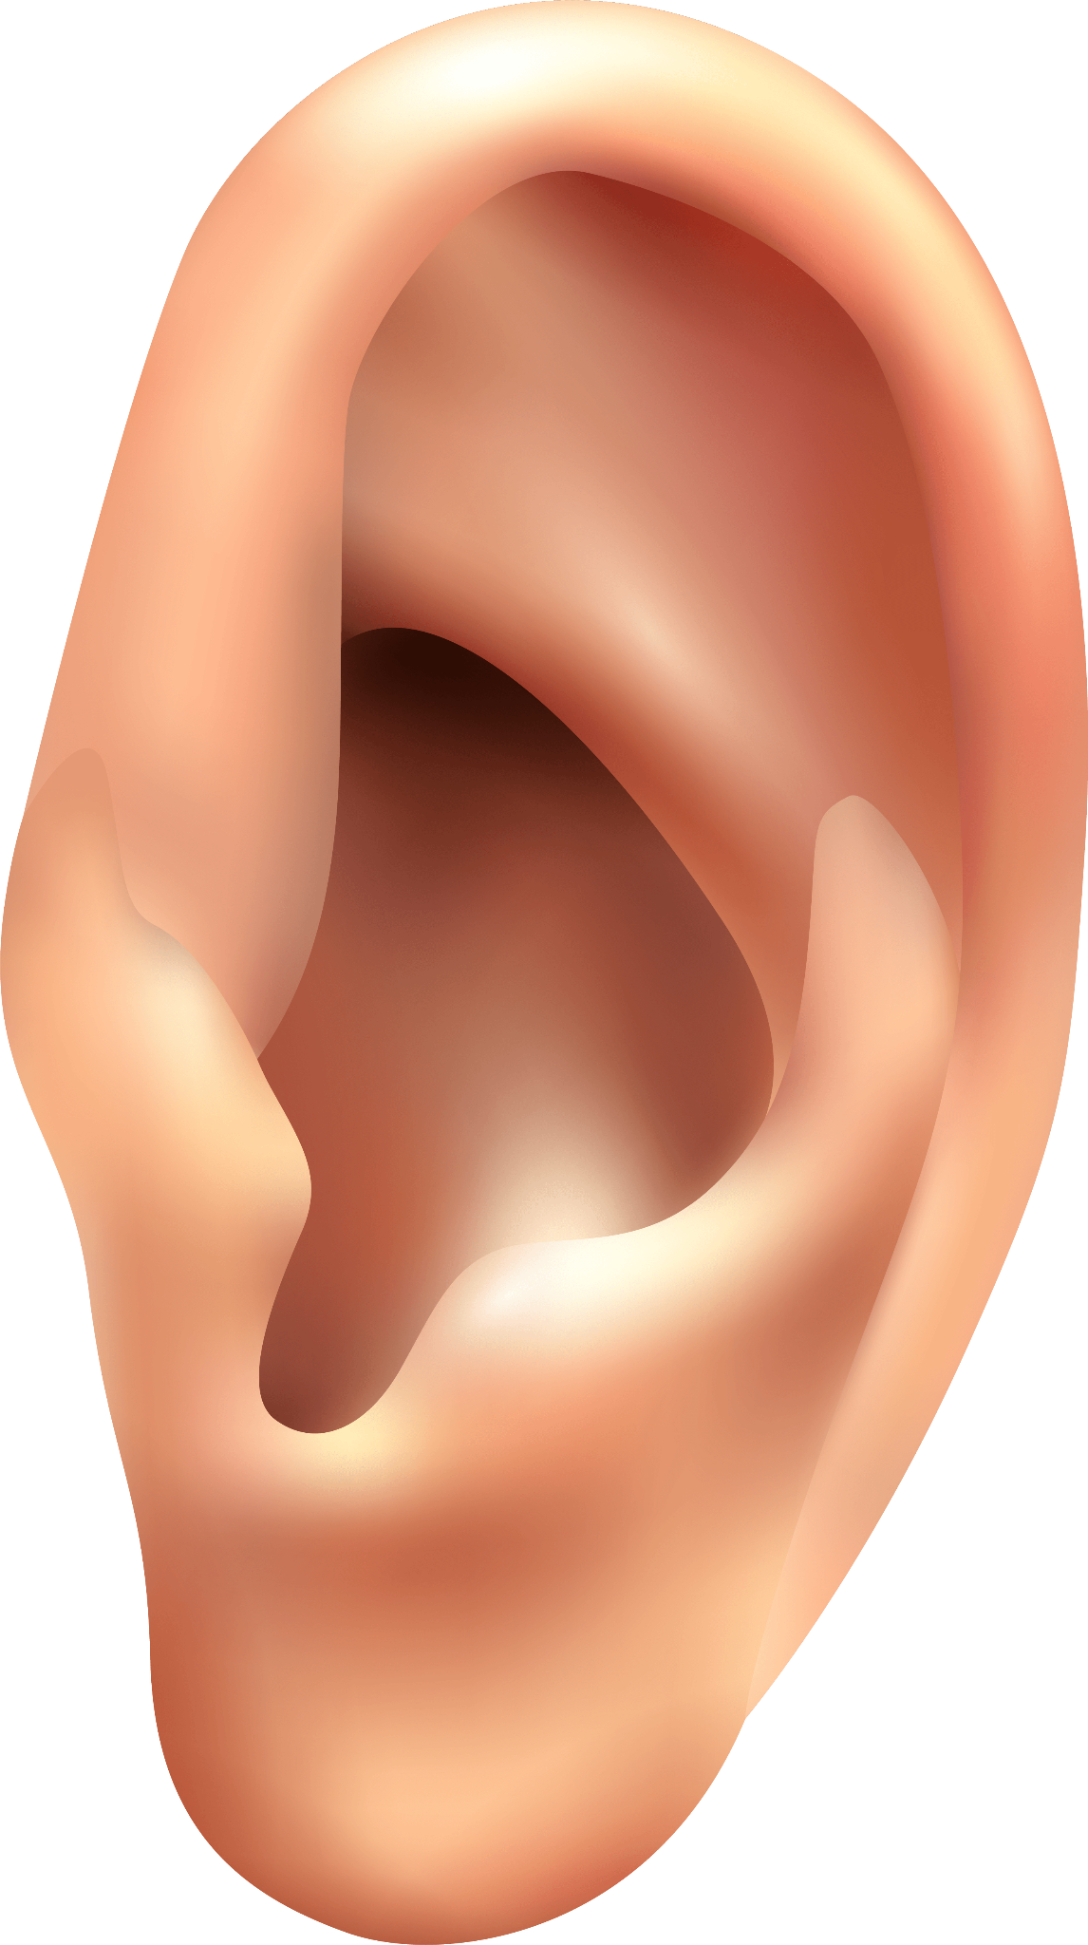
How We Hear
How We Hear
How We Hear
By Team Tunes

Slide 2
TABLE OF CONTENTS
01
02
03
04
Introduction
Problem Definition
05
Ear Anatomy & Cochlea Anatomy
Topic Of Concern, Purpose, Challenges & Literature Review
Results & Conclusion
Graphs & Analysis
How We Hear
PDE Model
Experimental Work
Lesser & Berkley Model
Resonance Analysis
Flowchart Of Algorithm

Slide 3
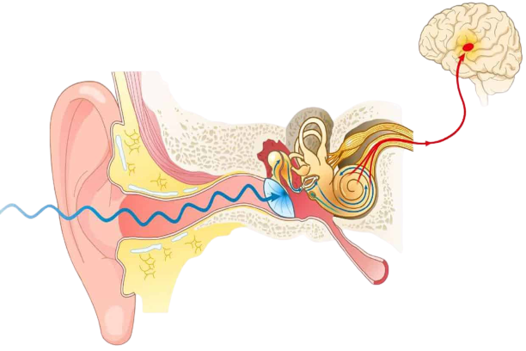
Overview
How We Hear
Hearing as a perception process consists of several stages, starting off from the outer ear, going over the middle ear, reaching the inner ear at which most of central events relating to hearing occur, up to the brain.
How We Hear

Slide 4
01
Introduction
How We Hear
How We Hear
Ear Anatomy

Slide 5
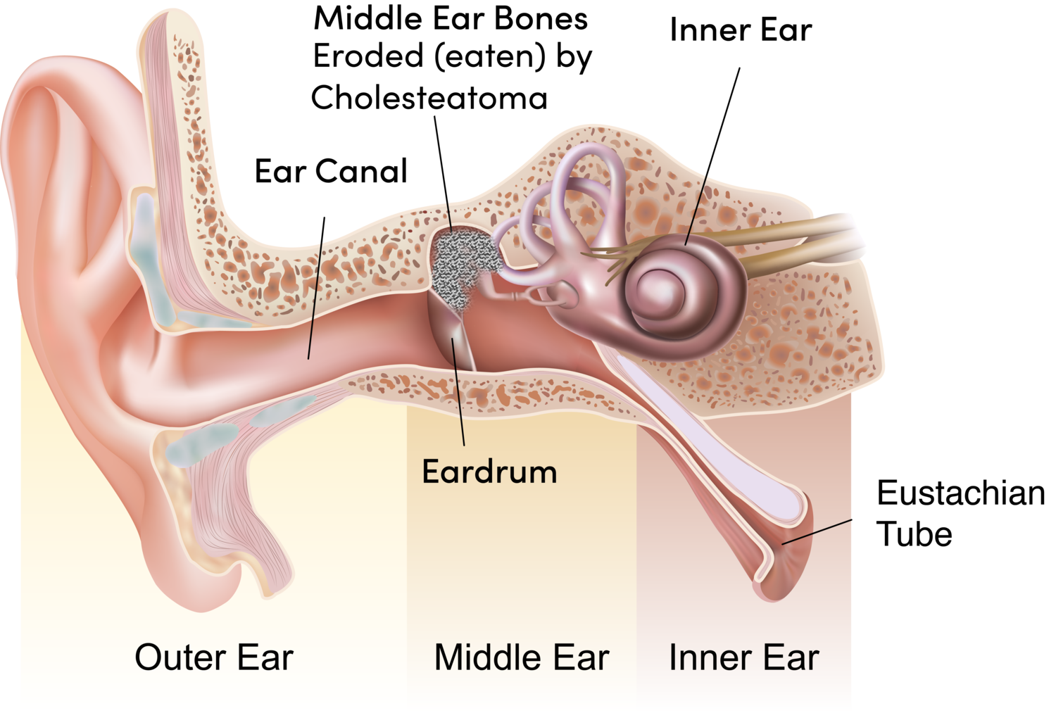
Ear Anatomy
01
02
03
How We Hear
The Human ear has three major components which hand over the Transmitted sound wave
OUTER EAR
MIDDLE EAR
INNER EAR

Slide 6
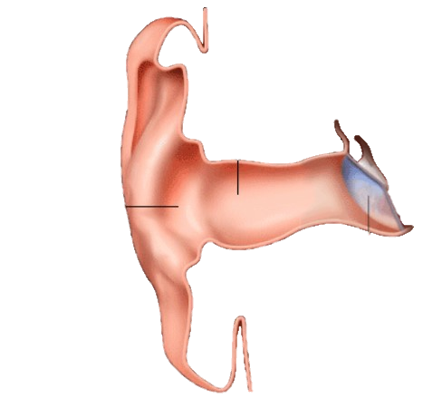
Outer Ear
How We Hear
Function
Performs an initial filtering of the sound waves
Increases the sound pressure gain at the tympanic membrane in the 2 to 7 kHz region.
Aids sound localization
Pinna
Ear canal
Concha
Eardrum

Slide 7
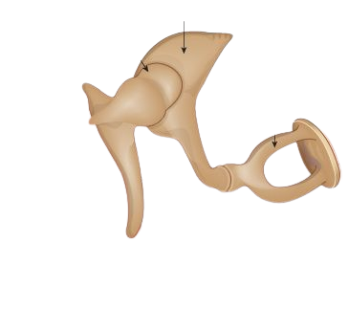
Middle Ear
How We Hear
Function
transmit the sound vibrations from the tympanic membrane to the cochlea by focusing the energy of tympanic membrane on the oval window of the cochlea
Incus
Head of
malleus
Stapes
Tympanic
membrane
manubrium of malleus

Slide 8
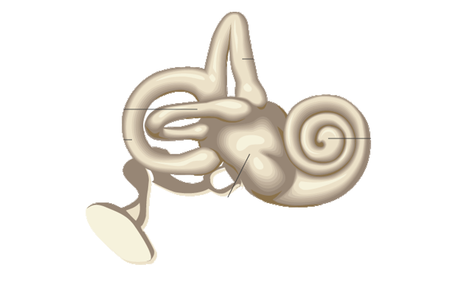
Inner Ear
Vestibular Apparatus
provides the sense of balance and the information about body position
Anterior semicircular canal
Lateral semicircular canal
Cochlea
Posterior semicircular canal
Cochlea
How We Hear
Responsible for the transduction of sound
Vestibule

Slide 9
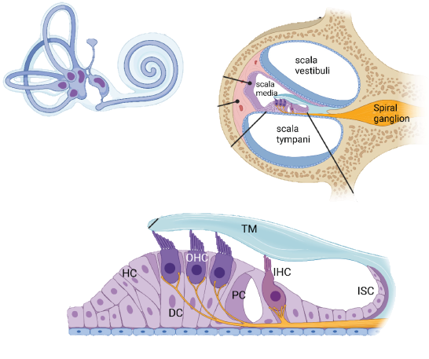
Cochlea Anatomy
Cross Section
How We Hear
Cochlea
SV
Three compartments twisted into spiral
Two separating membranes (BM and Reissner’s)
Organ of Corti mounted by TM
Auditory nerve
SL
Organ of Corti
Basilar membrane

Slide 10
02
Problem Definition
How We Hear
How We Hear
Topic Of Concern, Purpose, Challenges
& Literature Review

Slide 11
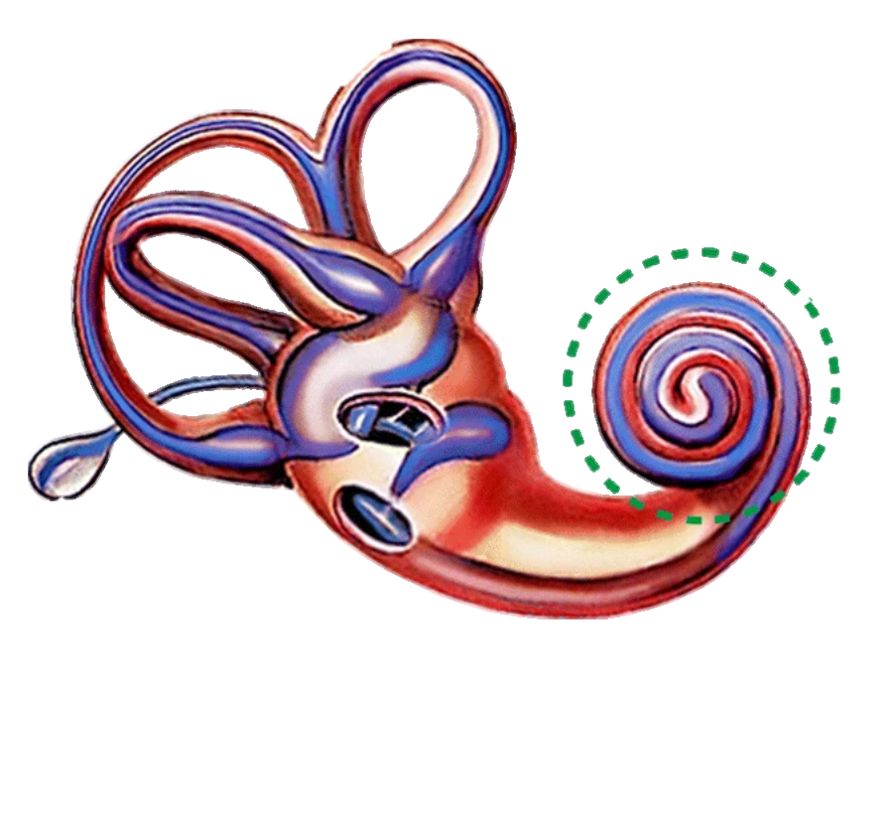

Topic of concern
How We Hear
We are taking up one aspect of the hearing process, by standing out the role which is played by the Basilar membrane in the process of transduction of sound
Apex
How We Hear
Base

Slide 12
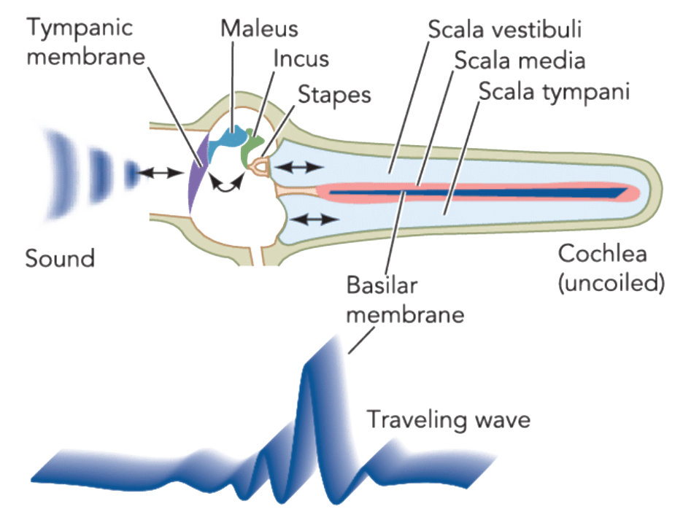
Purpose
How We Hear
The purpose is to enhance our visualization and understanding of the hearing process and to understand why our hearing range is limited.

Slide 13

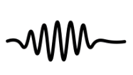
Challenges
Inaccessibility
Infinitesimal vibrations
How We Hear

Slide 14
Literature Review
01
02
05
04
03
How We Hear
Georg von Békésy
Peterson & Bogert
The pioneer of this aspect of research and the developer of the place theory
Both have Developed The first mechanical theory of the cochlea
Neely
Has come out with the best parameters of the mechanical response of the cochlea
Rhode
Lesser & Berkley
Has enhanced the previous model by adding physical parameters
Basilar membrane as setoff harmonic oscillators

Slide 15
03
PDE Model
How We Hear
How We Hear
Lesser & Berkley Model
Resonance Analysis

Slide 16
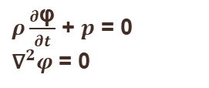
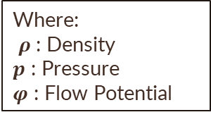
Lesser & Berkley Model
How We Hear
They have considered the cochlea as a system of fluid mechanics.
Navier‐Stokes set of equation have been used to describe the motion of cochlea internal fluids.
Navier‐Stokes set of equation after complying with assumptions:
How We Hear
Where:
$ρ$ : Density
𝒑 : Pressure
𝝋 : Flow Potential
$ρ\frac{∂\text{φ}}{∂t}$ + $p$ = 0
${\text{∇}}^{2}φ$ = 0

Slide 17
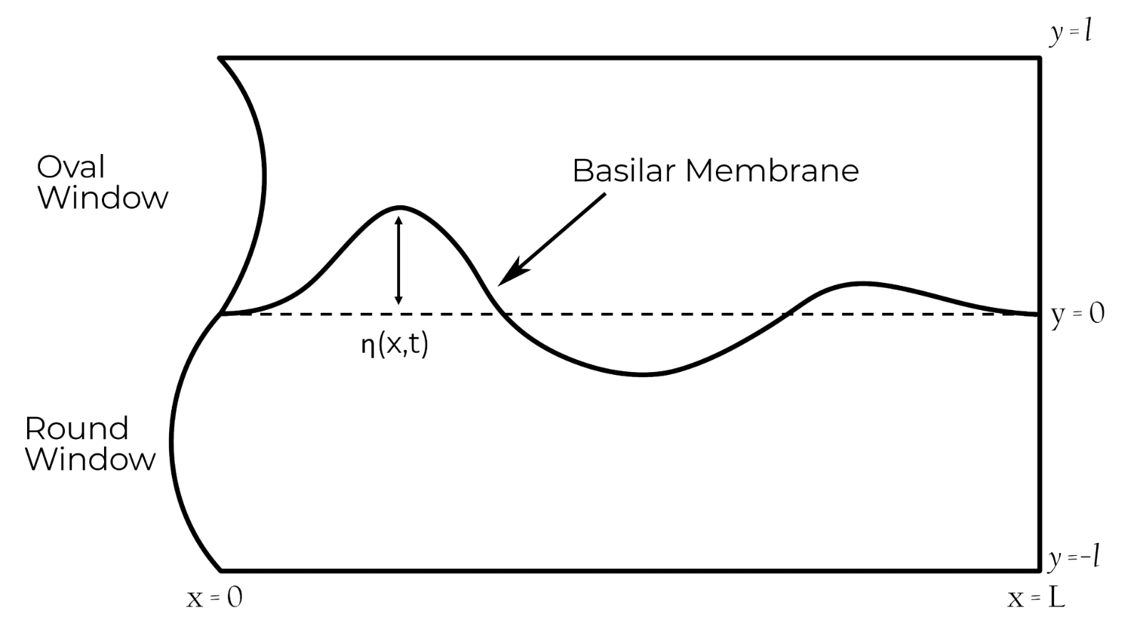
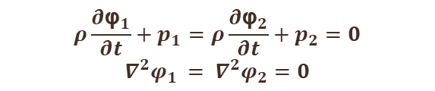
By combining Navier‐Stokes set of Equations of upper and lower chambers:
Upper Chamber
$$ρ\frac{∂{\text{φ}}_{1}}{∂t}+p_{1}=ρ\frac{∂{\text{φ}}_{2}}{∂t}+p_{2}=0$$
$$∇^{2}φ_{1 }= ∇^{2}φ_{2}=0$$
Lower Chamber
How We Hear

Slide 18
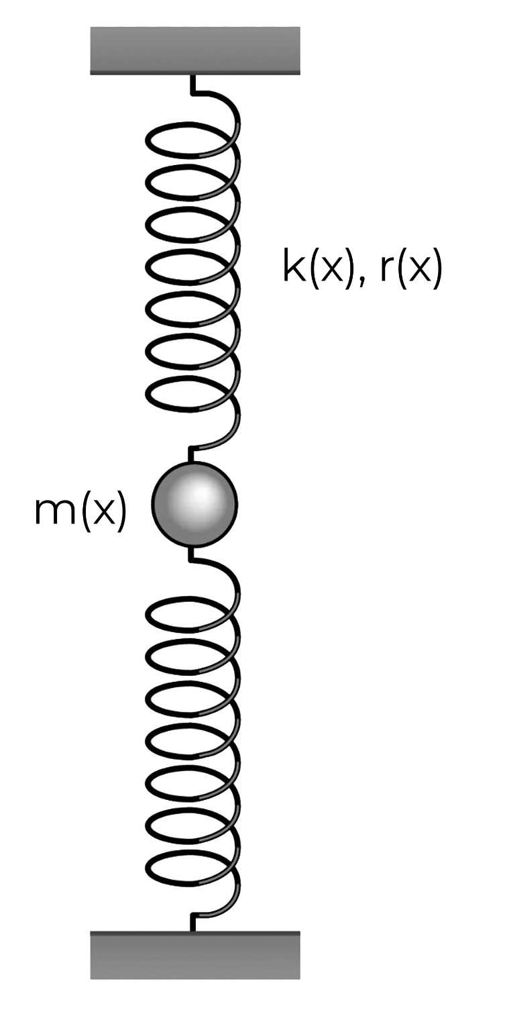
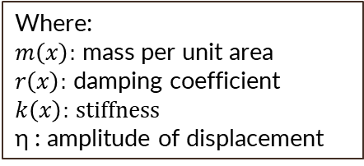
The movement of the membrane is controlled by pressure difference of the cochlea’s internal fluids
Each point of the basilar membrane is modeled as a simple damped harmonic oscillator with mass, damping, and stiffness that vary along the length of the membrane
How We Hear
By combining the fluids equation of the upper and lower chamber with the harmonic oscillator equation:
How We Hear
Where:
$m\left(x\right):$ mass per unit area
$r\left(x\right):$ damping coefficient
$k\left(x\right):$ $stiffness$
η : amplitude of displacement
$$m\left(x\right){\text{η}}_{tt}+r\left(x\right){\text{η}}_{t}+k\left(x\right)\text{η}=p_{2}−p_{1}$$

Slide 19
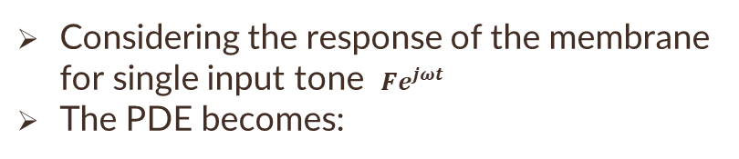
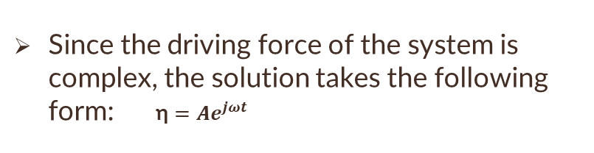
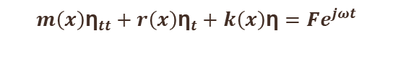
Resonance Analysis
How We Hear
Considering the response of the membrane for single input tone $Fe^{jωt}$
The PDE becomes:
$$m\left(x\right){\text{η}}_{tt}+r\left(x\right){\text{η}}_{t}+k\left(x\right)\text{η}=Fe^{jωt}$$
Since the driving force of the system is complex, the solution takes the following form: $\text{η}=Ae^{jωt}$

Slide 20
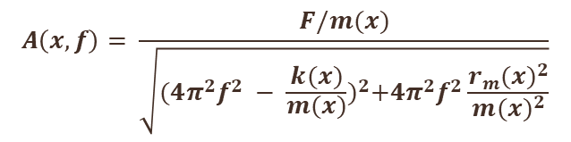
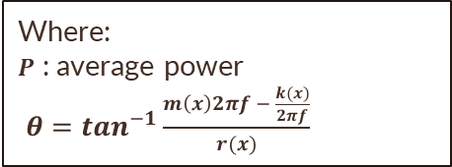
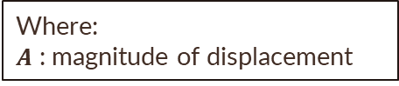
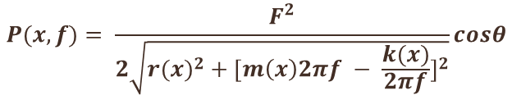
By getting the first and second derivatives and substituting
$$A\left(x,f\right)= \frac{F/m(x)}{\sqrt{{(4π^{2}f^{2} − \frac{k(x)}{m(x)})}^{2}+4π^{2}f^{2}\frac{{r_{m}(x)}^{2}}{{m(x)}^{2}}}}$$
Where:
$A$ : magnitude of displacement
By derivation and multiplying by the driving force
How We Hear
Where:
$P$ : average power
$θ=\tan^{−1}\frac{m\left(x\right)2πf − \frac{k(x)}{2πf}}{r(x)}$
$$P(x,f)= \frac{F^{2}}{2\sqrt{r{(x)}^{2} + {[m\left(x\right)2πf − \frac{k(x)}{2πf}]}^{2}}}cosθ$$

Slide 21
04
Experimental Work
How We Hear
How We Hear
Flowchart of Algorithm

Slide 22
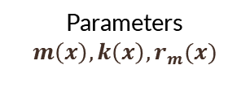
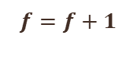
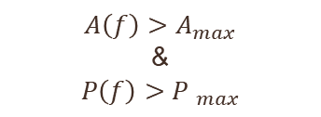
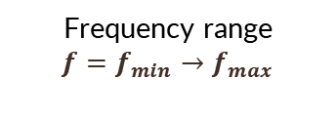
Flowchart Of Algorithm
How We Hear
Start
End
𝑓 is resonance frequency
Distance x
YES
$$A\left(f\right)>A_{max}$$
&
$$P\left(f\right)>{P }_{max}$$
Parameters
$$m\left(x\right),k\left(x\right),r_{m}(x)$$
Frequency range
$$f=f_{min}→f_{max}$$
$$f=f+1$$
NO

Slide 23
05
Results & Conclusion
How We Hear
How We Hear
Graphs & Analysis

Slide 24
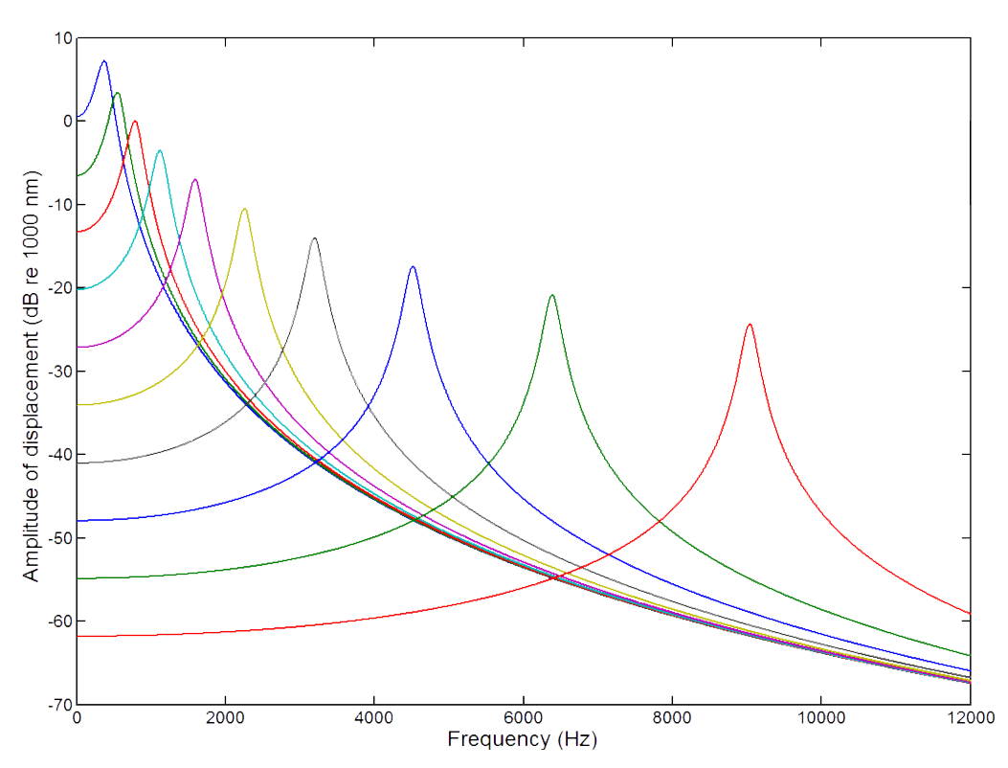
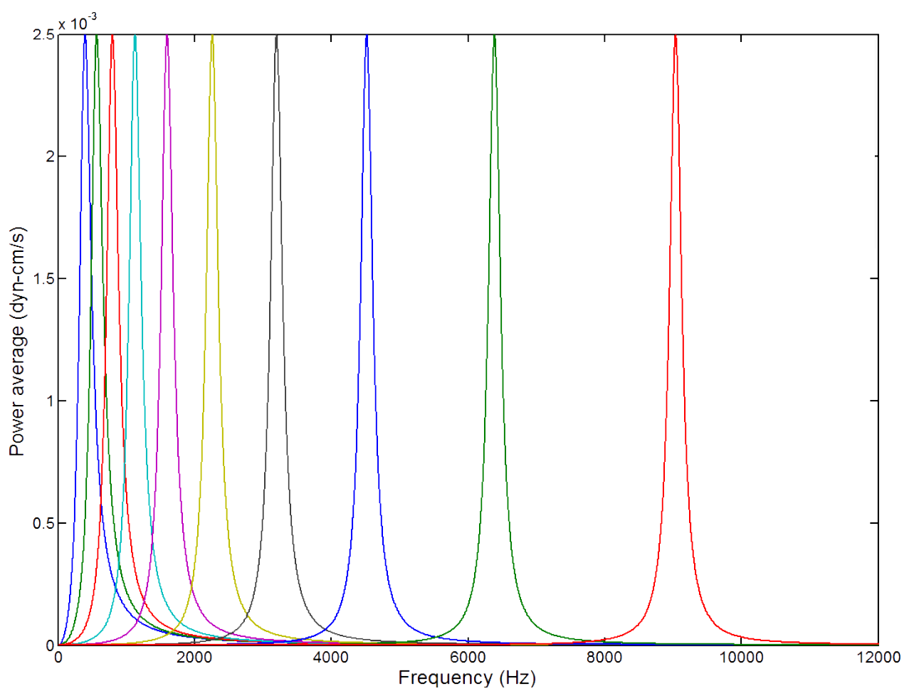
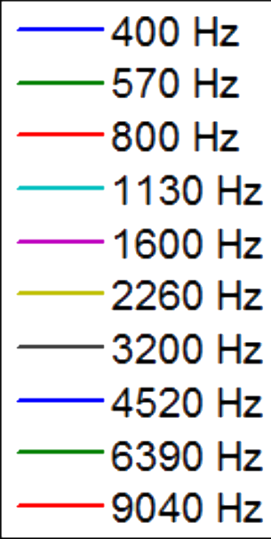
Results
How We Hear

Slide 25
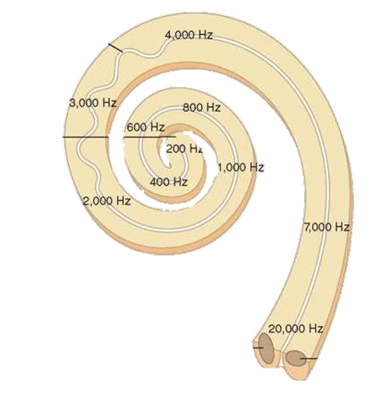
Conclusion
How We Hear
Frequency Analyzer
Maximum Power Transfer
Each point selectively resonate with specific frequency
BM
Such power can activate hair cells and generate impulses
Apex
Base

Slide 26
THANKS!
How We Hear
Course Instructor: Dr/Samah El-Shafiey
How We Hear
Reem Adel, Kareem Salah, Mohamed Sami, Mohamed Sayed, Mohamed Mosilhe, Hager Samir, Yassmin Sayed, Youssef Ahmed

Slide 27

How We Hear
Scan For Resources
How We Hear

